Slide 1

IoT based Polyphonic Synthesizer
Roll No. | Name | Student ID
78 | Shreyas Mhatre | 23106135
95 | Samiksha Patil | 24206010
100 | Shravani Rane | 24206003
Project Guide
Mr. Mahesh Pawaskar

Slide 2
Outline
Introduction
Literature Survey of the Existing Systems
Limitations of the Existing Systems
Problem Statement
System Design
Technologies and Methodologies
Implementation of the project
Conclusion
References

Slide 3

Introduction
Real-World Observation:
Electronic music is growing, but synthesizers are expensive and complex.
Beginners and hobbyists lack affordable and customizable options.
ESP32 is a low-cost microcontroller with strong audio and control features.
Current solutions don’t offer easy-to-use, budget-friendly polyphonic synths.
Motivation:
Saw the need for a DIY-friendly, affordable synthesizer.
Wanted to combine touch and MIDI control for flexible input.
Inspired by the potential of ESP32 in music and sound projects.

Slide 4
Project Objectives:
Build a polyphonic synthesizer using ESP32.
Add a custom touch interface for real-time control.
Make it open-source, low-cost, and easy to expand.

Slide 5

Literature Survey of the Existing System
Existing Solutions:
Commercial Synths (e.g., Roland, Korg): Great sound, but expensive and not customizable.
Open-Source Synths (e.g., Mozzi, Teensy): Affordable, but mostly
monophonic and complex to set up.
Software Synths (VSTs, DAWs): Flexible, but need a PC and are not portable.
DIY MIDI Controllers: Focus on control only, no built-in sound generation.
Issues Identified:
High cost and limited access for beginners.
Lack of integrated touch + sound + MIDI in one device.
Hard to customize or expand existing systems.

Slide 6
User Survey:
Who?: Music learners, hobbyists, indie artists.
Needs?: Low-cost, portable, customizable, easy-to-use synthesizer.
Expectations: Good sound, simple controls, MIDI & touch support.
Technology Overview:
Tech / Method | Pros | Cons
ESP32 | Cheap, powerful, Wi-Fi / MIDI | Needs DAC for best audio
DACESP32 library | Easy audio or Arduino | Monophonic, basic sounds
Touch Input | Interactive, intuitive | Needs calibration
MIDI Protocol | Widely supported | Needs decoding on ESP32
Observation:
There’s a strong gap between expensive commercial synths and basic DIY options. A smart, affordable synth with ESP32 + Touch + MIDI can fill this gap effectively.

Slide 7
Problem statement
Most existing polyphonic synthesizers are expensive, complex, and
lack customization options. Beginners and hobbyists need a low- cost, portable solution that supports real-time touch control and MIDI input. This project aims to create an affordable and user- friendly polyphonic synthesizer using the ESP32 platform.

Slide 8

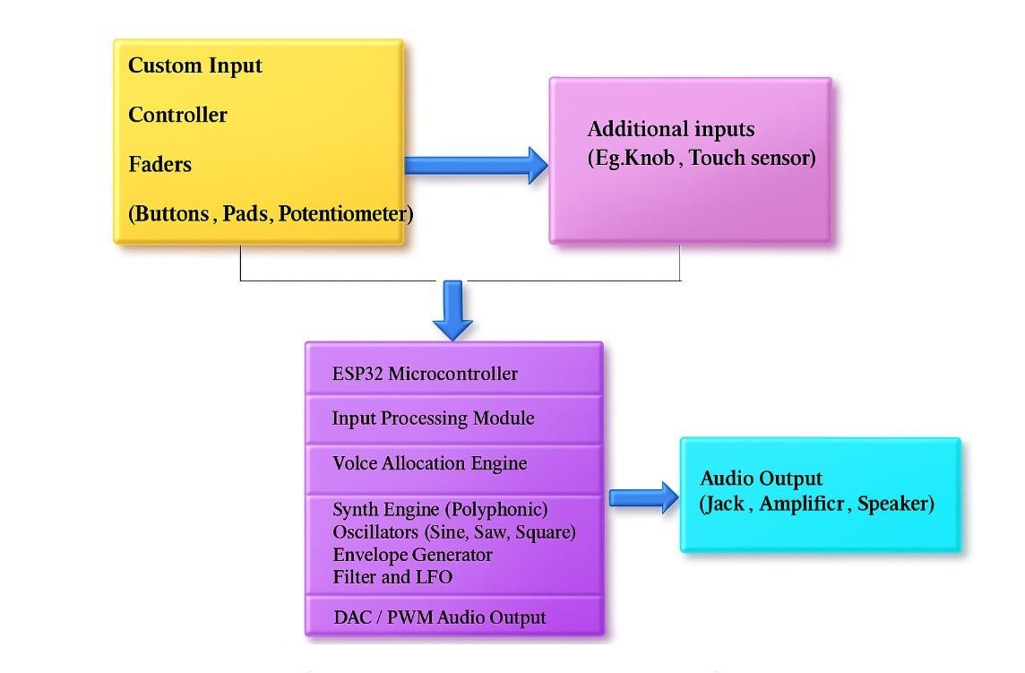
System Design

Slide 9
Technologies and Methodologies
Component | Technology Used | Purpose
Core Processor | ESP32 | Handle synthesis, input, and output
Sound Engine | Custom / DACESP32 | Generate polyphonic audio
Input (Touch) | Tactile switches | Real-time note triggering
Playing Notes | Button Matrix | Fast Instant Note detection
Audio Output | Internal / 12S DAC | Analog signal output
Development Tools | Arduino IDE, C / C++ | Code development and uploading
Optimization | Real-time scheduling | Ensure audio and input processing is smooth

Slide 10
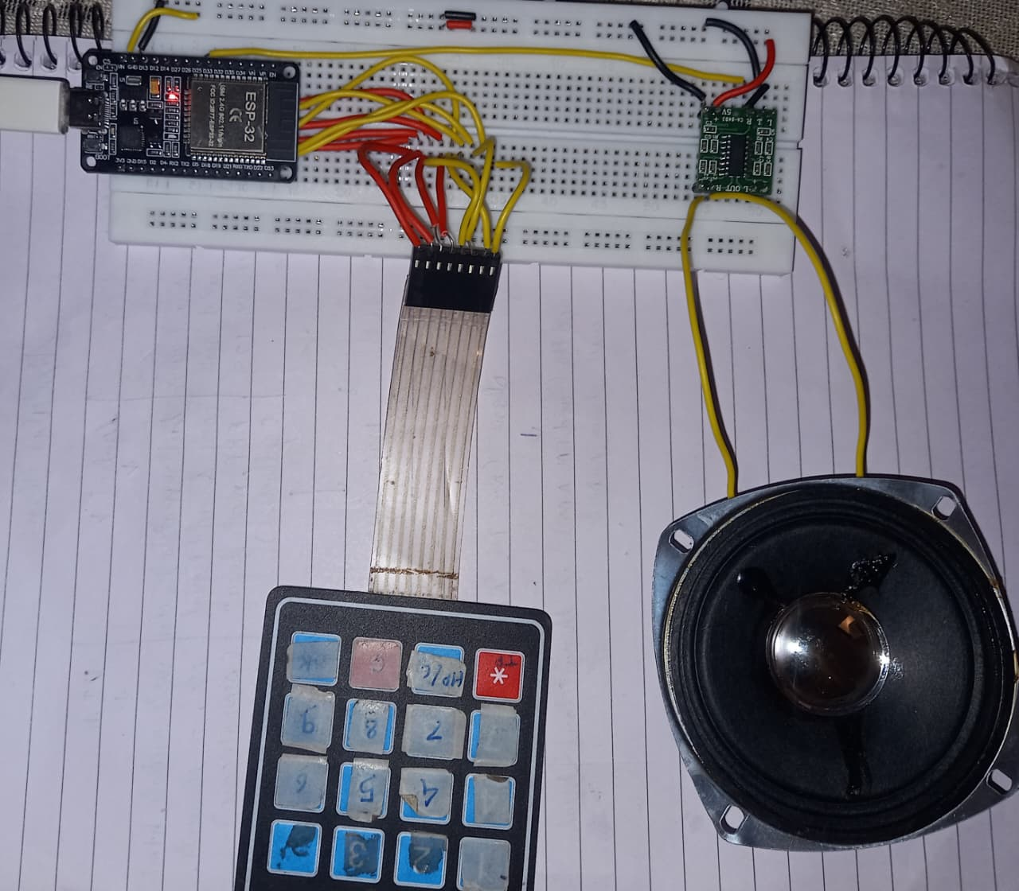
Implementation of the Project

Slide 11
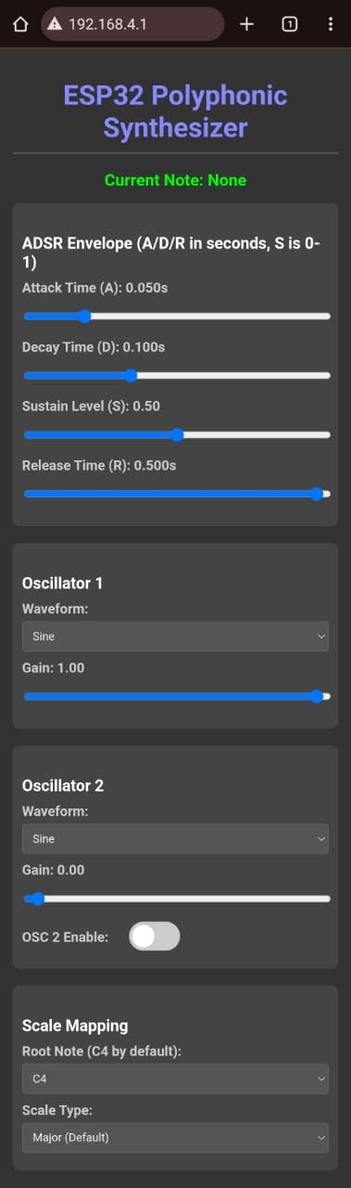
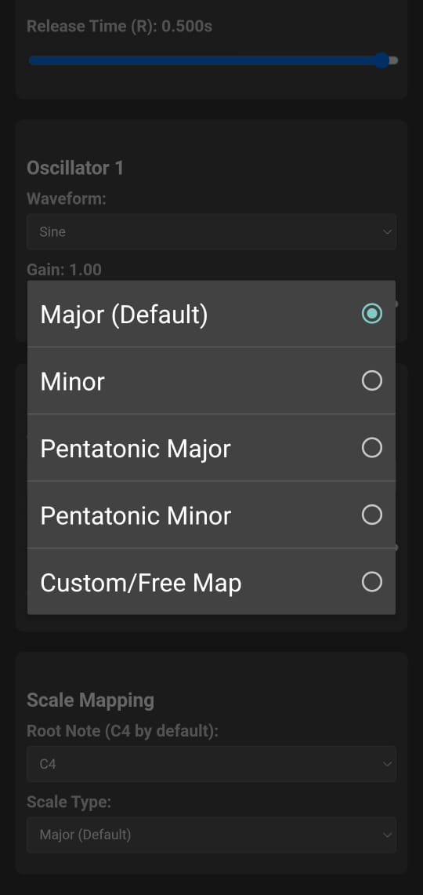

Slide 12
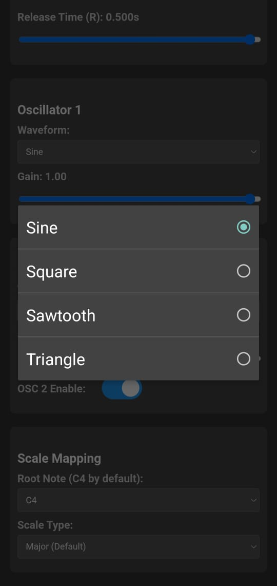
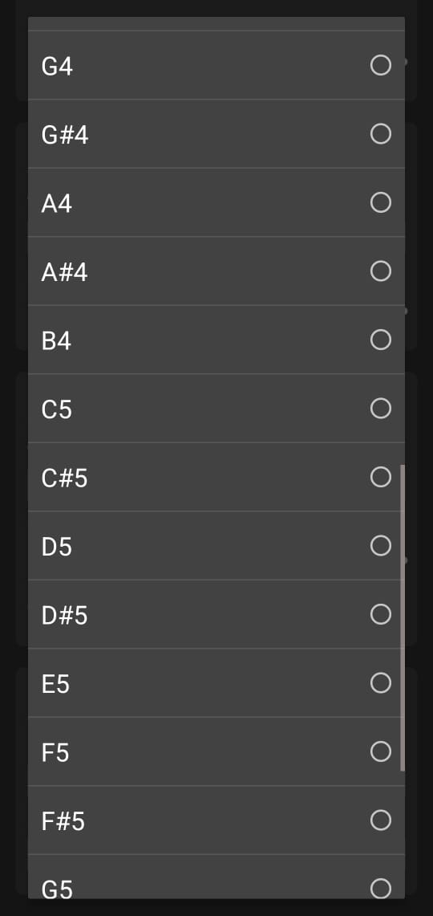

Slide 13
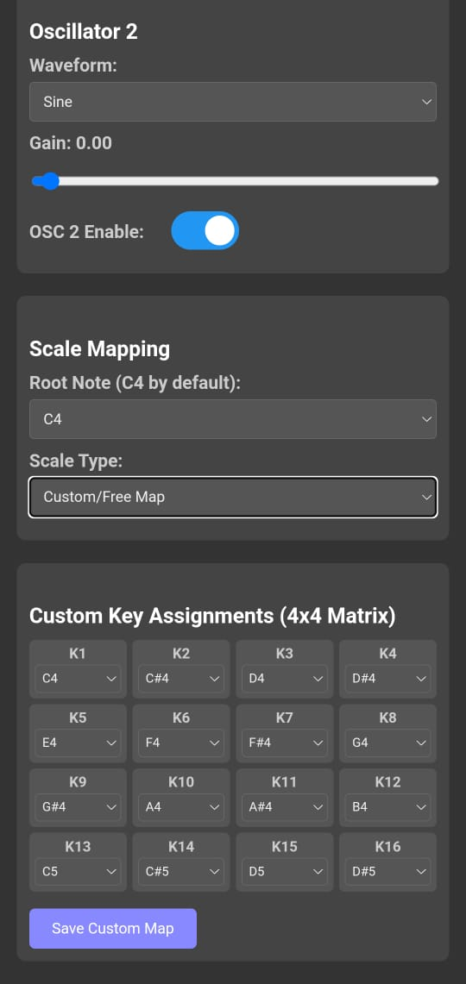

Slide 14
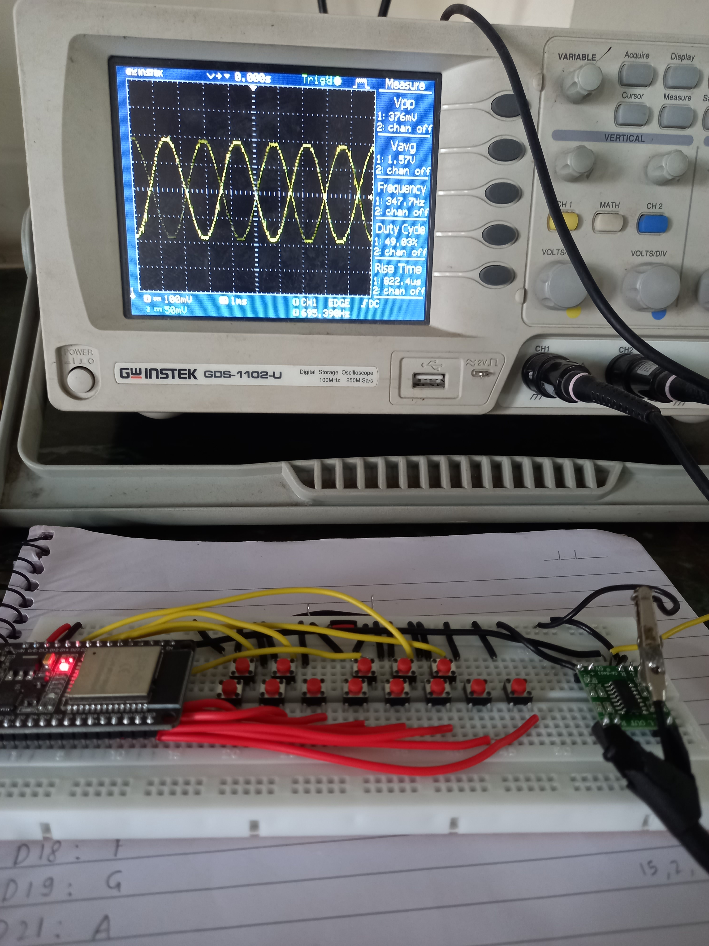

Slide 15

Conclusion
This project aims to
bridge the gap between expensive commercial
synthesizers and limited DIY audio systems by developing an affordable, portable, and customizable polyphonic synthesizer using the ESP32 microcontroller. Through the integration of real-time touch, users can interact with the synthesizer intuitively and flexibly.
By combining various technologies like capacitive sensing, audio waveform generation and digital-to-analog conversion, the system delivers a complete and functional music synthesis platform. The use of open-source tools and low-cost hardware ensures that the synthesizer remains accessible to students, hobbyists, and independent musicians.
Overall, this project not only provides a practical solution to a real-world problem but also opens up further opportunities for enhancement and customization in future versions.

Slide 16

References
Roth, J., Keller, D., Castañeda, O., & Studer, C. “An Aliasing-Free Hybrid Digital-Analog Polyphonic Synthesizer”, IEEE Journal of Solid-State Circuits, vol. 59, no. 2, pp. 358–370, 2023. https://arxiv.org/abs/2311.18774 arxiv.org
Sankar, S. S., Kovar, S., Pospisilik, M., & Galda, M. “Analysis of Conducted and Radiated Emission on a Self-oscillating Capacitive Touch Sensing Circuit”, IEEE Transactions on Electromagnetic Compatibility, vol. 67, no. 4, pp. 1234–1243, 2024. https://arxiv.org/abs/2412.06961 arxiv.org
Shan, H., Zhang, B., Zhan, Z., Sullivan, D., Wang, S., & Jin, Y.
“Invisible Finger: Practical
Electromagnetic Interference Attack on
Touchscreen-based Electronic Devices”, ACM Conference on Computer and Communications Security, pp. 112–125, 2024. https://arxiv.org/abs/2402.02267 arxiv.org

Slide 17
Thank You...!!

